Slide 1
Let’s talk about public speaking
How to be not-terrible at public speaking
Frode Aarebrot

Slide 2


Slide 3
About me
Packaged App Development Associate Manager
Notes:
Co-op term with Solvera in 2007
Started full-term with Solvera in 2008, been there ever since
SharePoint, WCF, WinForms, Rest APIs, Middleware services, MVC
Past 5 years -> Full-stack dev -> Angular + .NET Core APIs
Don’t have any communications training
Did my first public speaking engagement in 2011
Spoken at Regina Tech Community
Done X amount of sessions for Prairie DevCon
Done a couple of talks on game design for SIAST

Slide 4
Agenda
##
But… why?
##
Who can do a presentation..?
##
Before
##
During
##
After

Slide 5
But… Why?

Slide 6
You were voluntold
Notes:
No choice
Boss wants you to do one because you’re an expert on a topic
At Solvera we used to do monthly meetings, people were encouraged to present
Well… Sometimes you don’t have a choice. Your boss shows up at your desk and tells you that because you’re the only one who knows topic X, we want you to do a presentation for the development group so people who are interested can learn more. And you can totally say no. But depending on the place you work, that can sometimes be a career limiting move.

Slide 7
Networking
Notes:
Good way to network / get your name out there
Inside and outside your current org
Might make your manager happy
Might make you more visible to upper management
Speaking externally can be good advertisement for your organization
Might make hiring agents aware of your name
Might land you a contract if you’re bid somewhere
Can help you stand out from other candidates and land you a job!
If you’re more desirable as a hire, might help salary negotiations at your current job

Slide 8
It’s fun!
Notes:
It can be fun!
Myself, I enjoy attending sessions
Learn new tech
Can be hard to get approved to attend conferences, especially with travel
Easier to be approved if you’re attending as a speaker
Sometimes you get nice perks
Prairie DevCon has a fancy dinner for instance
Going to conferences can be fun! Sure the 60 minutes you’re up here talking might be terrifying, especially your first few times. Personally I quite enjoy going to sessions and learn about new tech. And sometimes it can be really hard to get approval to go to a conference as an attendee. But it’s much easier to get approval to go as a speaker!

Slide 9
Who can present?

Slide 10
Anyone!
Notes:
- That’s not true Frode, I’m an introvert, I don’t like speaking to people

Slide 11
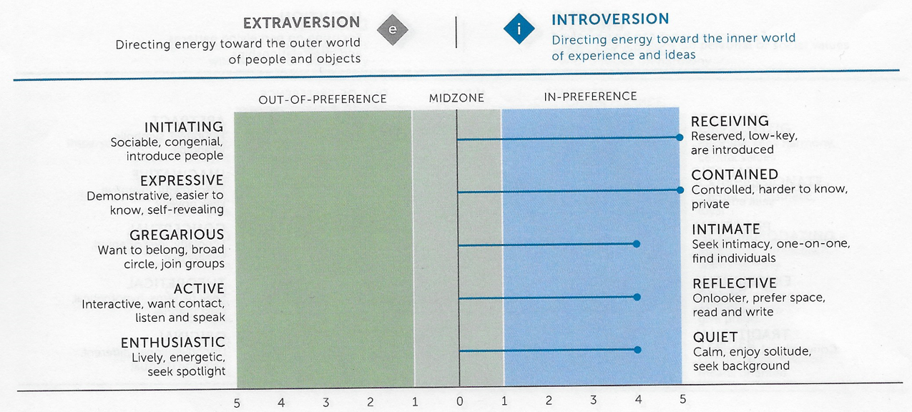
Anyone!
Notes:
Don’t have to be extrovert
How many here are extroverts?
How many are introverts?
I’m assuming those that didn’t raise their hands => introverts, that’s how we roll
Don’t have to be expert
15 years ago I was terrified of public speaking
Always nervous => Usually, I still am

Slide 12
What to do before…

Slide 13
Decide on a topic
Notes:
Figure out what you want to talk about
Make sure you have enough material to cover 45-60 minutes
Make sure to leave room for questions and potential issues

Slide 14
Understand your audience
Notes:
Understand your audience
Talking to developers? Probably should do some code samples
Talking to product owners or management? Probably should be higher level

Slide 15
Practice! Practice! Practice!
Notes:
Practice
Run through on your own
It should be an agile process, doing practice runs gives you new ideas for things to include or things to change
Or you realize that something you were thinking of doing doesn't actually work all that well
Run through a small audience if you can, get feedback
Get practice in other ways if you can
Toastmasters for example
I usually do my presentations internally before going to the conferences

Slide 16
Ensure topic matches expectations
Notes:
Make sure your talk matches what the audience expects
Description should match what you're talking about

Slide 17
Natural flow
Notes:
Have a flow in your material
Make sure order makes sense
Connect things together
Segue from one to the other if you can

Slide 18
For slides, less is more
Notes:
Don't have too many words, they distract from your talking
People end up reading the text instead of listening to your speak

Slide 19
Concrete takeaways
Notes:
Have some small takeaways that the audience can apply

Slide 20
Use the bathroom!
Notes:
I try to always go use the bathroom close to before I do my session
You don’t want to sit/stand up here and have to use the bathroom, that’s no fun

Slide 21
What to do during…

Slide 22
Set expectations
Notes:
Set expectation, "I've done this for X years" or "I'm not an expert, but here's something I learned I wanted to share"

Slide 23
Try to avoid monotony
Notes:
Try not to be monotonous
Don’t just read off your slides or notes
Rather use them as queues as to what you've covered so you don't miss material
If you can, try to use your normal talking voice, not a "reading" or "presenting voice"
Some people turn into newscasters
Some people read our loud, or very pre-rehearsed
Natural on-the-fly talk tends to be better, even if you're pre-rehearsed it dozens of times
Requires practice! You'll get better with time

Slide 24
Speak with enthusiasm
Notes:
Speak with enthusiasm!
Better to listen to someone who's enthusiastic, but maybe not super knowledgeable, than someone who knows a lot but just drones on in a boring way
If you're excited about your material, your audience is more likely to be excited

Slide 25
Don’t hum and haw… Uh… Ehm…
Notes:
Don't hum and haw, uh, eh
This is really, _really_, hard for most people, especially when starting out
Short pauses are better, just be quiet
Really nerve-wrecking when you're up there, but audience doesn't notice
Try to notice if you have ticks
I go tsk tsk tsk with my tongue

Slide 26
Have water available

Slide 27
Answering questions
Notes:
If the material allows do questions as they come up, but try to leave time for questions at the end as well
Make sure you understand what they're actually asking for, if you're not sure, ask for clarification
Repeat the question so everyone can hear it
Try to not get sidetracked when answering, I'm really bad at this. End up not answering and then having to ask "what was your questions again?"

Slide 28
A little humor can go a long way
Notes:
A little bit of humor can go a long way
Don't have to pre-write jokes, although you can, but if you think of something funny it's ok to make jokes
Loosens the mood, I like to throw in a couple of jokes up front to settle down a little bit
Don't try too hard, if audience doesn't get the joke (or it's not funny), can be a bit awkward

Slide 29
What to do after…

Slide 30
Ask for feedback
Notes:
Ask for feedback
You won't improve if you don't get feedback

Slide 31
Follow the feedback!
Notes:
Follow feedback
You also won't improve if you don't listen to the feedback!
Takes 10,000 hours to master <- use this quote
Although not all feedback is useful! You need to learn to distinguish what is good feedback and what is bad feedback.

Slide 32
Questions?
frode.aarebrot@accenture.com
Notes:
I’ll share this presentation with Darcy, he always puts the slides up on the website after

Slide 33
Thank You

